Slide 1
Trump’s Ahoy! Predictors of 2016 Trump Votes
Ying Li, Kristin Bail, Josh Holmes, and Miles Williams
University of Illinois at Urbana-Champaign

Slide 2
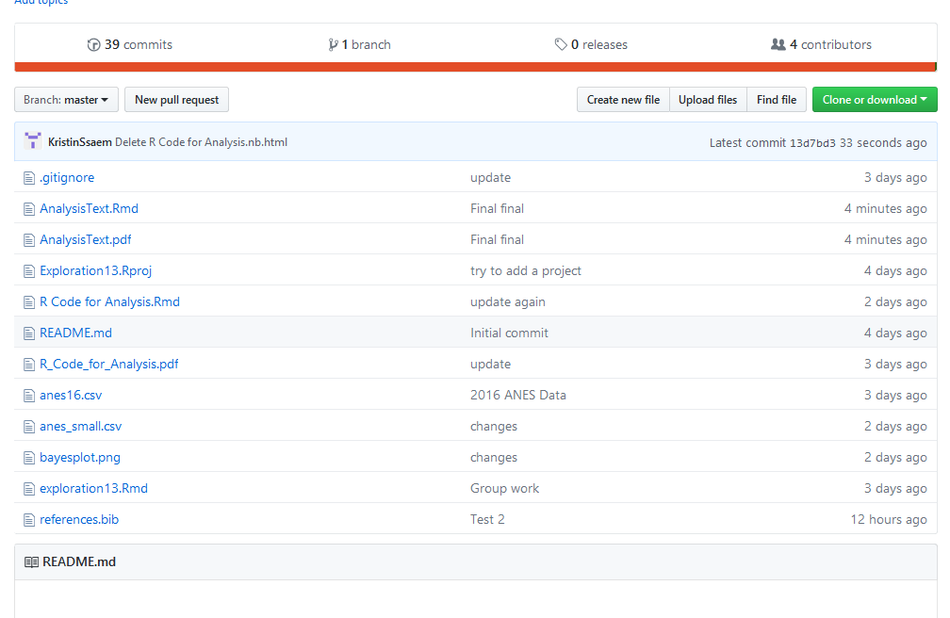
Workflow
Created a repository
Separate files for
Complete ANES data
Cleaned data
File with R code for analysis
R markdown file with complete analysis
Figure files
Bib file for references
Everything contained in repository

Slide 3
Variables
Which predicts Trump vote more strongly -- socioeconomic status or beliefs about immigration?
Outcome is binary indicator of whether respondents voted for Trump
Proxied socioeconomic status as highest educational attainment
Immigration attitudes proxied by attitudes toward government policy on undocumented immigration

Slide 4
Control Variables
Party identification– self-identified Republican
Race– white

Slide 5
Analysis
Estimate a Bayesian logit model with uninformative priors to determine the estimated effects of covariates on the likelihood that a respondent said they intended to vote for Trump pre-election.
Use the distributions of the estimates from the model as priors for a second Bayesian logit model predicting Trump vote post-election

Slide 6
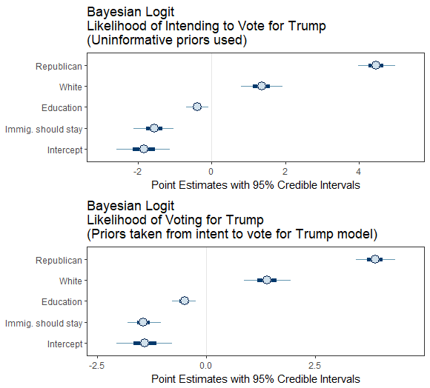
Results

